Slide 1



K.RAMAKRISHNAN COLLEGE OF ENGINEERING
(AUTONOMOUS), TRICHY
TITLE: QUIZ APPLICATION
PRESENTED BY SUPERVISOR
DHANVARSHINI T Mr.V.KUMARARAJA, M.E., (PhD),
8115U23EC017 AP/CSE.
6/12/24

Slide 2
PRESENTATION OVERVIEW
Introduction
Objective
Problem Statement
Java Concepts
5. Modules Used
6. Architecture of the proposed system
7. Merits and Demerits
8. Program Execution and Output
9. Queries
6/12/24

Slide 3
INTRODUCTION
The Quiz Application with Login and Registration is a Java-based program that lets users register, login, and take quizzes.
It includes features like account creation, secure login, multiple-choice questions, and score tracking.
The application provides a simple and interactive way for users to learn and test their knowledge.
Combines secure user authentication with a dynamic quiz system.
6/12/24

Slide 4
OBJECTIVE
Provide Secure User Access:
Implement user authentication through registration and login for personalized access.
Enhance Learning Experience:
Deliver an interactive platform for quizzes that makes learning engaging and enjoyable.
Facilitate Dynamic Quiz Management:
Support customizable multiple-choice quizzes with real-time score calculation.
Promote User-Friendly Interface:
Utilize a graphical user interface (GUI) for intuitive navigation and enhanced usability.
Ensure Flexibility and Scalability:
Design the application with a modular architecture to allow for easy addition of features like progress tracking and new quizzes.
6/12/24

Slide 5
PROBLEM STATEMENT
Develope a quiz application for educational purposes. The application needs to handle quiz creation, user responses, scoring, and provide feedback.
6/12/24

Slide 6
JAVA CONCEPTS
Object-Oriented Programming(OOP):
  GuiQuizAppWithLogin class as the main controller.
  Question class to represent quiz questions.
  Fields like text, options and correctAnswer in the question class are private with public getters for controlled access.
2. Java Swing(GUI):
Usage of JFrame, JButton, JLabel, JTextField, JPasswordField, JRadioButton, and JOptionPane for creating the GUI.
3. Event Handling:
ActionListeners to handle button clicks for login, registration, quiz navigation, and answer submission.
6/12/24

Slide 7
JAVA CONCEPTS
4. Hash Map
  Use of HashMap to store and validate user credentials efficiently.
  Array(questions) to manage quiz questions in sequence.
5. Real-Time Feedback and Dynamic Updates
  Real-time score calculation and feedback.
  Dynamic update to the GUI using revalidate() and repaint() after each action.
6/12/24

Slide 8
MODULES USED
USER REGISTRATION
Function Name: ‘showRegisterScreen()’
Description: Allow new users to input a unique username and password. Ensures fields are not empty and checks for username uniqueness. UserCredentials Hashmap confirms completion.
USER LOGIN
Function Name: ‘showLoginScreen()’
Description: Prompts existing users for their username and password. Validates credentials using the user credentials Hashmap.
6/12/24

Slide 9
MODULES USED
4. DISPLAY QUESTION
Function Name: ‘displayQuestion()’
Description: Displays the current question with options using Jlabels and JRadioButtons. Validates the selected answer, updates the score if correct an proceeds to the next question or ends the quiz upon completion.
5. CALCULATE AND DISPLAY RESULTS
Function Name: ‘showResults’
Description: Shows the final score and feedback after quiz completion.
6/12/24

Slide 10
MODULES USED
6. LOGOUT FUNCTIONALITY
Function Name: ‘logout()’
Description: Allows users to log out after completing the quiz, resets the score and question index, and redirects to the login/register screen for reauthentication.
6/12/24

Slide 11
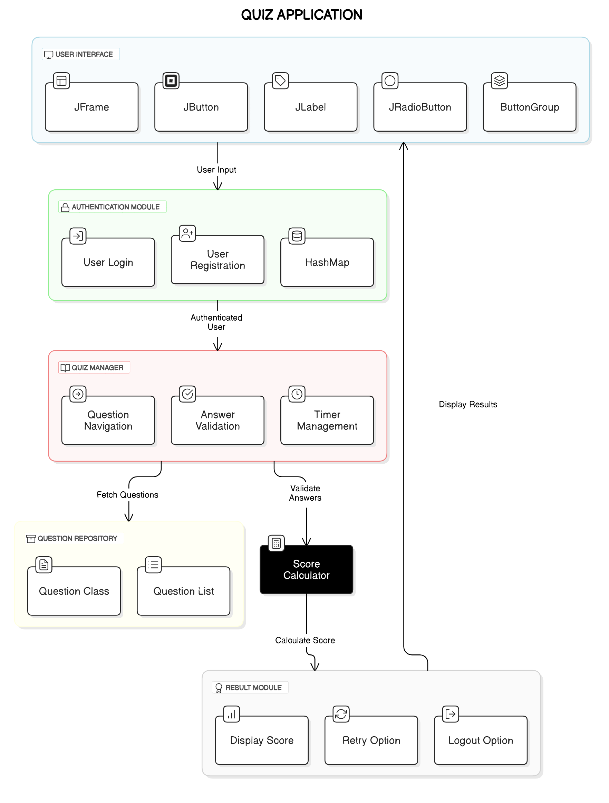
ARCHITECTURE OF PROPOSED SYSTEM
6/12/24

Slide 12
MERITS AND DEMERITS
MERITS | DEMERITS
User-Friendly Interface | Limited Question Bank
Secure logic System | Basic functionality
Real Time scoring | No Database integration
Platform for Learning | Limited user management
6/12/24

Slide 13
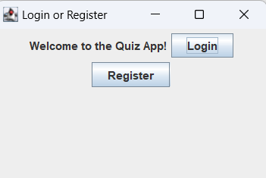
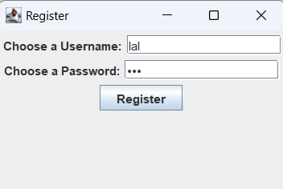
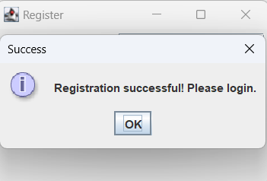
PROGRAM EXECUTION AND OUTPUT
1.Register/Login Page
2.Registration
3.Registration Successful
6/12/24

Slide 14
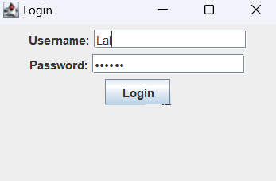
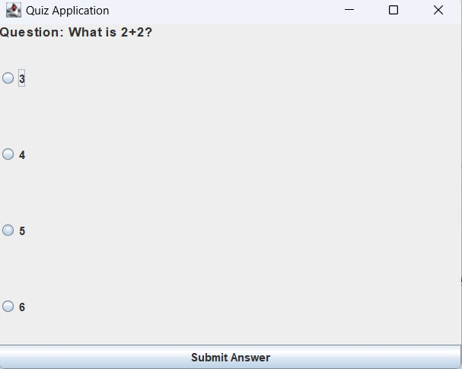
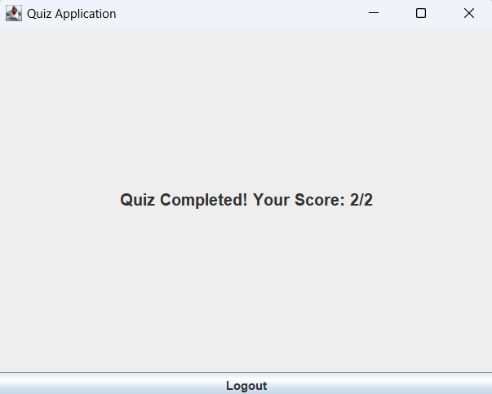
PROGRAM EXECUTION AND OUTPUT
4.Login Page
5.Question Display
6.Result
6/12/24

Slide 15
THANK YOU
6/12/24

